Slide 1
Technology for Success: Computer Concepts

Slide 2
Module 1
Impact of Digital Technology

Slide 3
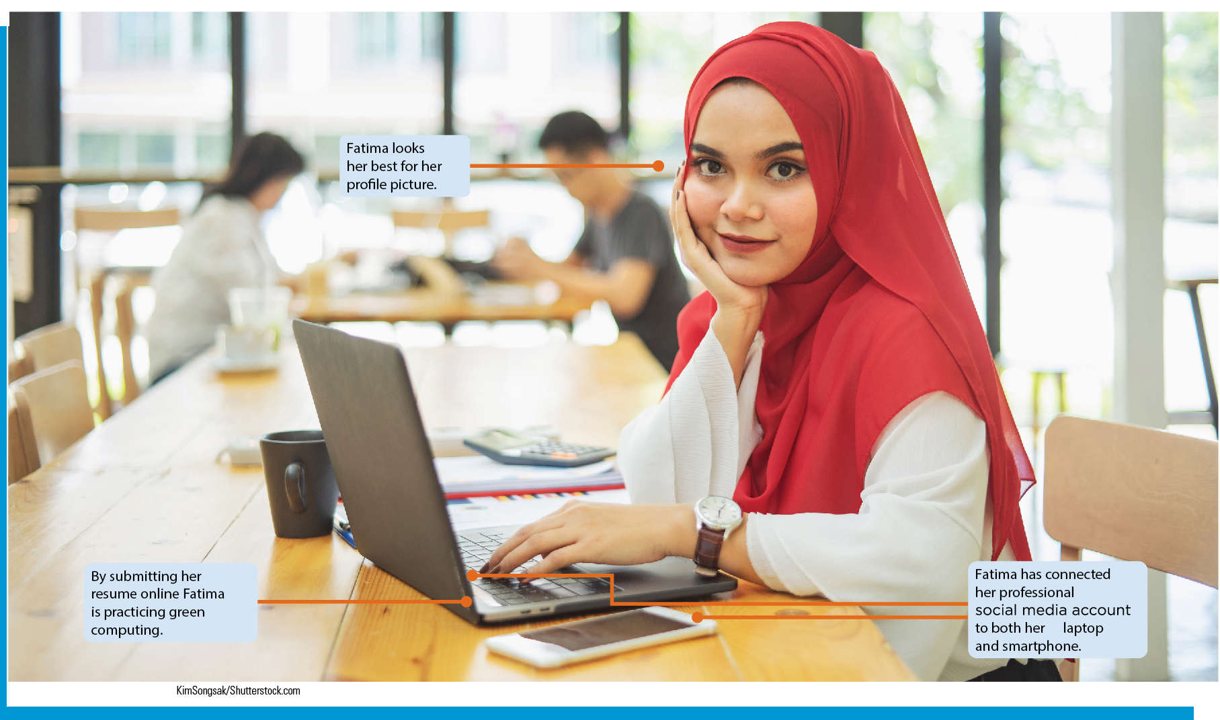
Lesson Objectives
Explain the evolution of society’s reliance on technology
Develop personal uses for technology to help with productivity, learning, and future career growth
Explain the role of technology in the professional world

Slide 4
The Evolution of Reliance on Technology
Outline the history of computers
Explain the impact of the “Internet of Things” and embedded computers
Discover uses for artificial intelligence
Explore the impact of virtual reality

Slide 5
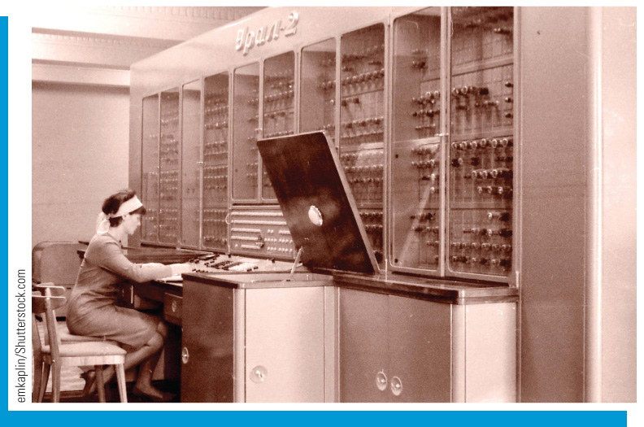
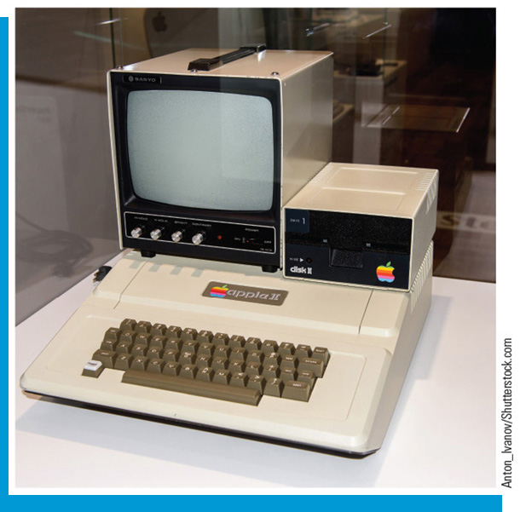
Outline the History of Computers
First generation – used vacuum tubes
Next generation – replaced vacuum tubes with transistors
19 60s – integrated circuits
19 71 – microprocessor
19 70s and 19 80s – the personal computer (pc) gained popularity

Slide 6
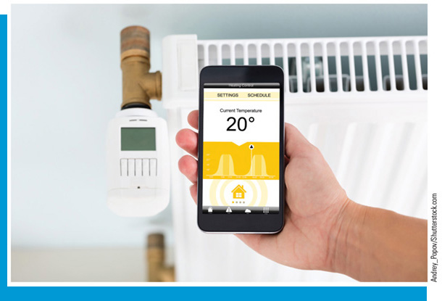
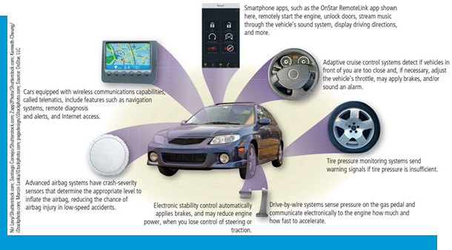
“Internet of Things”/Embedded Computers
Internet of Things (I o T)
Processors are embedded in many products (smart devices), which communicate via the Internet or wireless networks
Embedded computers
Have a specific purpose
Small and have limited hardware but enhance the capabilities of everyday devices

Slide 7
Discover Uses for Artificial Intelligence
Artificial Intelligence (A I)
The technological use of logic and prior experience to simulate human intelligence
Capabilities
Speech recognition
Virtual reality
Logical reasoning
Creative responses

Slide 8
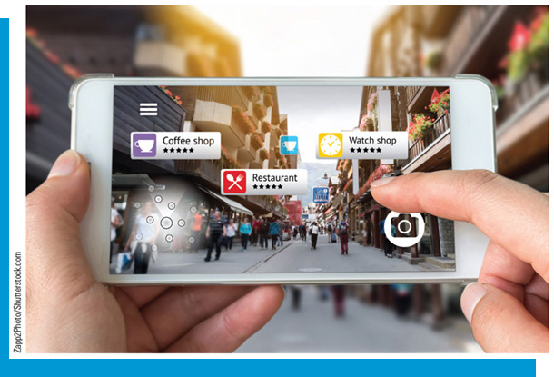
Explore the Impact of Virtual Reality
Virtual Reality (V R) - The use of computers to simulate a real or imagined environment that appears as a three-dimensional (3-D) space.
Augmented Reality (A R) - A type of V R that uses an image of an actual place or things that adds digital information to it.

Slide 9
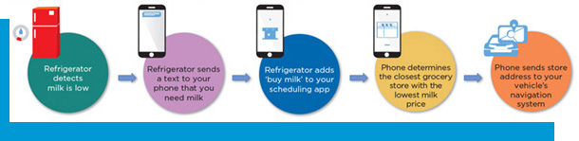
Personal Uses for Technology
Use technology in daily life
Use technology to enhance productivity and learning
Use technology to assist users with disabilities
Apply green computing concepts to daily life

Slide 10
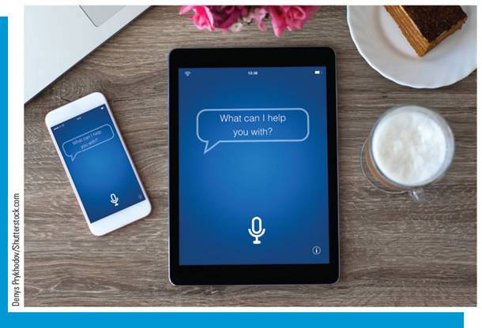
Use Technology in Daily Life
Artificial Intelligence
Virtual assistants, video games, navigation apps, security, etc.
Natural language processing – computers interpret and digitize spoken works and commands (digital assistants, for example)

Slide 11
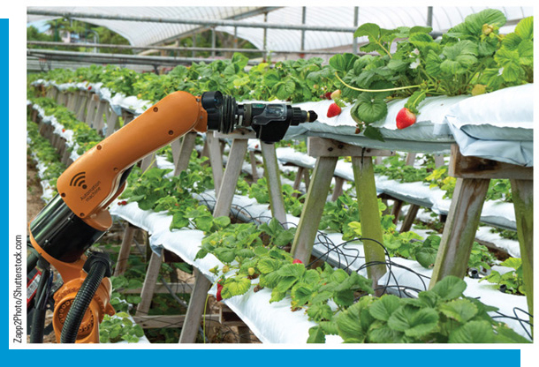
Use Technology to Enhance Productivity
Robotics
Useful in situations where it is impractical, dangerous, or inconvenient to use a human
Robotic arms and cameras can assist surgeons
Enterprise computing—each department of a large company uses technology specific to its function

Slide 12
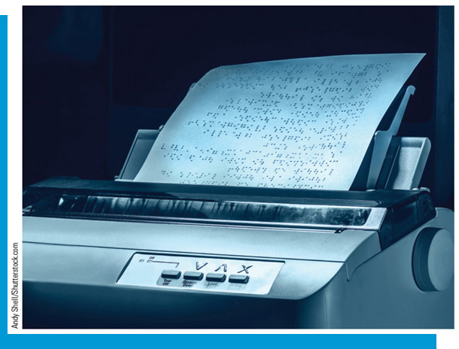

Technology to Assist Users with Disabilities
Laws
Americans with Disabilities Act (A D A)
Individuals with Disabilities Education Act (I D E A)
Technologies
Screen readers
Alternative text (alt text)
Captioning and speech recognition software
Input devices for people with physical disabilities

Slide 13

Green Computing Concepts
Green Computing
Reducing electricity and environmental waste generated from technology
ENERGY STAR program
Recycling products
Using paperless communications
Telecommuting

Slide 14
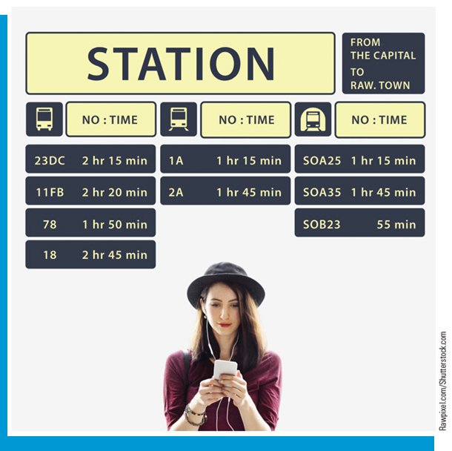
Technology in the Professional World (1 of 2)
Explore technology careers
List the ways that professionals might use technology in the workplace
Explain the ways that teachers might use technology in K-12 education
Explain how various transportation services utilize technology to their advantage

Slide 15
Technology in the Professional World (2 of 2)
Explain the ways that technology assists the world of healthcare
Describe the ways that technology has impacted the world of manufacturing
Explain the ways that professions might use technology in higher education
Explore how you might prepare for a career in technology

Slide 16
Explore Technology Careers (1 of 2)
Software and apps
Technology equipment
I T departments
Technology service and repair
Technology sales
I T consulting

Slide 17
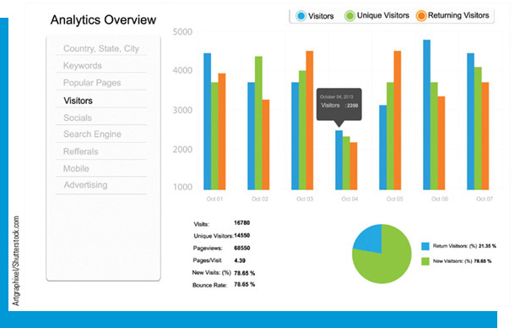
Explore Technology Careers (2 of 2)
System development
Web marketing and social media
Data storage, retrieval, and analysis
Information and system security

Slide 18
Use Technology in the Workplace
Working remotely
Telecommuting
Use of smartphones, the Internet, the cloud
Intelligent workplace
Some companies use a B Y O D (bring your own device) policy
Online collaborative productivity software

Slide 19
Technology in K-12 Education
Social networking
Promote school events
Work cooperatively on group projects
Teach concepts, such as anti-bullying
Intelligent classroom – technology is used to facilitate learning and communication

Slide 20
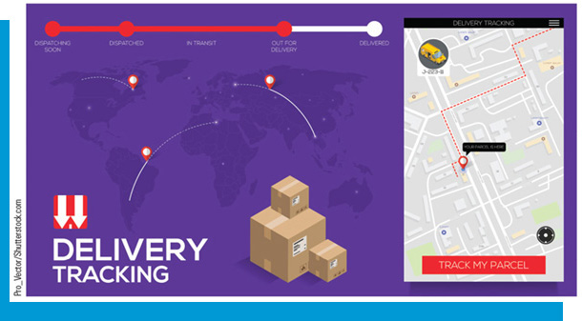
Technology in Transportation
Package tracking
Drivers use G P S technology to avoid traffic and hazardous conditions
Automated vehicles

Slide 21
Technology in Healthcare
Physicians use computers to monitor patients’ vital signs and research symptoms and diagnoses
Mobile health (m Health)
Healthcare professionals—access health records
Patients—monitor conditions and treatments
Medical monitoring devices
3-D printers

Slide 22
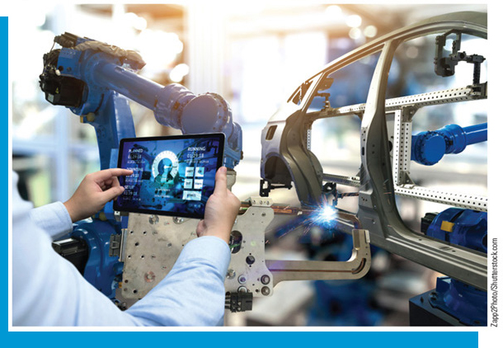
Technology in Manufacturing
Computer-aided manufacturing (C A M)—streamlines production and allows for shipping products more quickly
Robots perform work that is too dangerous, detailed, or monotonous for people
Part ordering through computers
Monitor assembly lines and equipment with machine-to-machine (M2M) communications

Slide 23
Technology in Higher Education
Learning Management System (L M S)—web-based training, allows students to:
Check progress on a course
Take practice tests
Exchange messages with instructors or other students
Take classes and earn degrees online
Ebooks—students can read and access content, such as videos, from devices

Slide 24
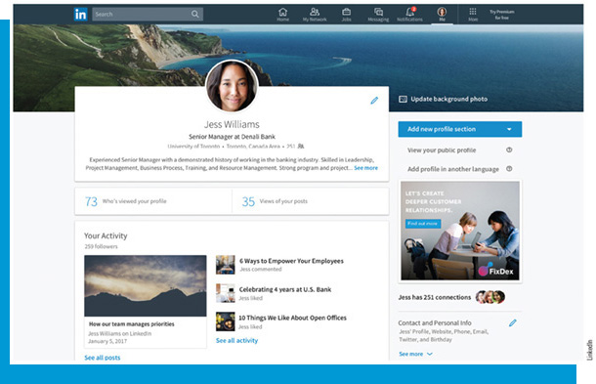
Preparing for a Career in Technology
Professional online presence
Upload resume
Proofread everything
Professional social networks
Certifications
Demonstrates knowledge in a particular area (software, hardware, operating systems, etc.)
Requires a commitment of time and money

